Slide 1
JAVA MINI PROJECT
TEAM MEMBERS
NIMMA SAI HRUDAY REDDY 19XJ1A0546
SAI NATH REDDY 19XJ1A0547
PRANAV KUMAR TEEPIREDDY 19XJ1A0553

Slide 2

ONLINE AIRWAY
RESERVATION
SYSTEM

Slide 3
OBJECTIVE : AIRWAY RESERVATION
FEATURES
SIGN UP
LOGIN
DESTINATION SELECTION
SELECTION OF FLIGHT
PASSENGER DETAILS
PAYMENT MODE
BOOKING TICKET

Slide 4
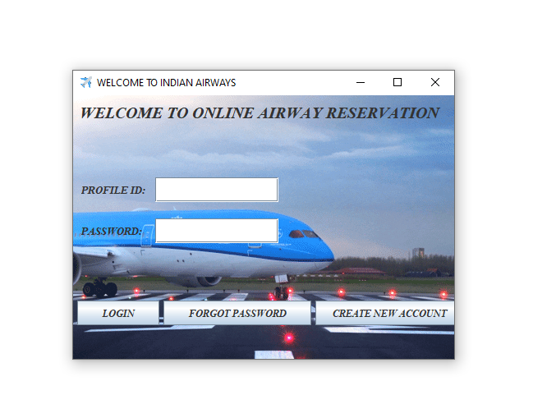
STEP 1
USER NEW TO THE AIRWAY PORTAL
SHOULD CREATE THEIR OWN
ACCOUNT.
SIGN UP BY SELECTING
“CREATE NEW ACCOUNT”

Slide 5
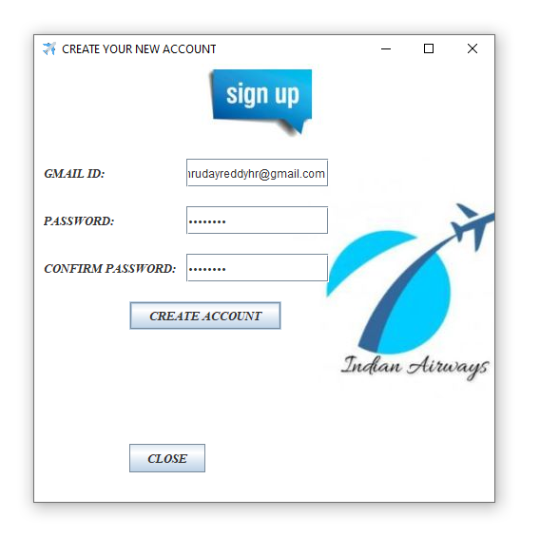
STEP 2
START SIGNING UP BY ENTERING YOUR GMAIL ID ,CREATE YOUR
OWN PASSWORD AND CLICK ON
THE BUTTON “CREATE ACCOUNT”.
YOUR ACCOUNT HAS BEEN
SUCESSFULLY CREATED.

Slide 6
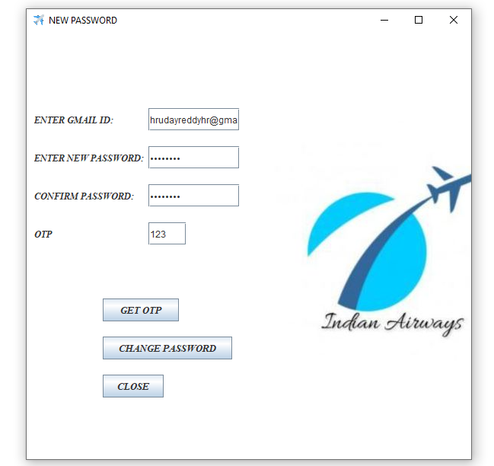
STEP 3
IF YOU FORGOT YOUR ACCOUNT
PASSWORD , YOU CAN CREATE NEW
PASSWORD BY CLICKING ON THE BUTTON “FORGOT PASSWORD”.
AND LOGIN WITH YOUR NEW
PASSOWORD.

Slide 7
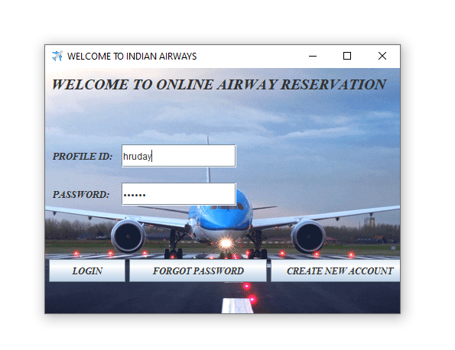
STEP 4
ENTER PROFILE ID AND PASSWORD.
CLICK ON THE “LOGIN” BUTTON
AFTER CREATING ACCOUNT.

Slide 8
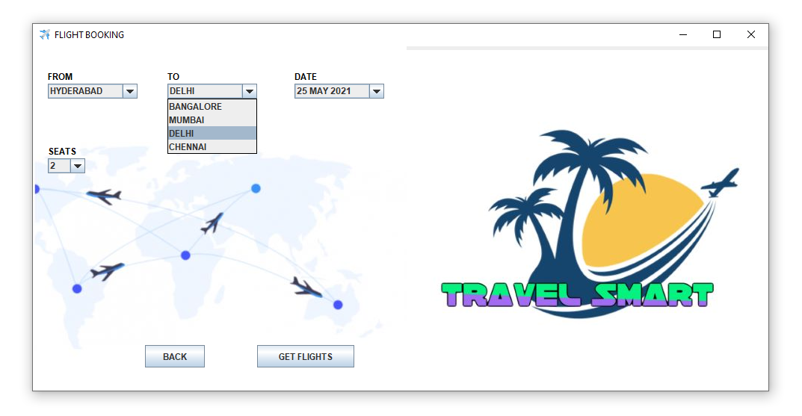
SELECT THE DESTINATION , DATE AND THE NUMBER OF PASSENGERS .
NOW CLICK ON THE BUTTON “GET FLIGHTS”.

Slide 9
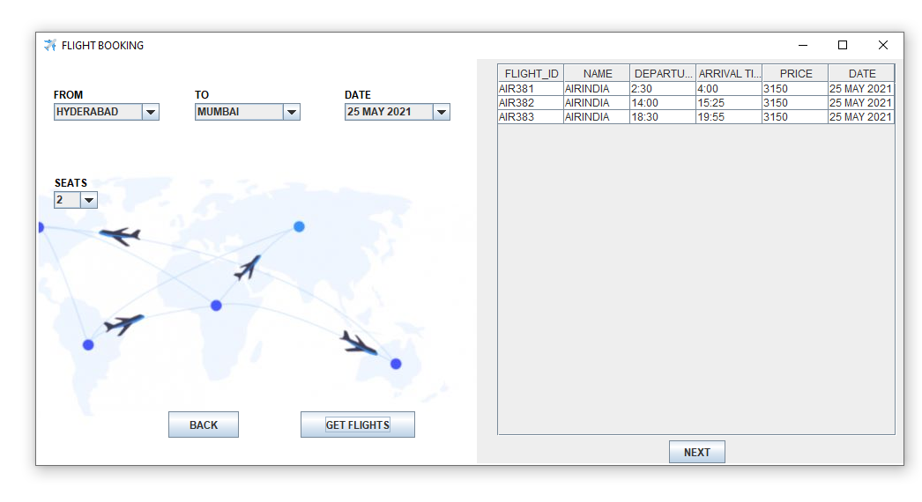
AVAILABLE FLIGHTS WILL APPEAR ON THE TABLE AND THE PASSENGER CAN SELECT THE FLIGHT THAT IS
CONVINIENT TO HIM/HER AND CLICK ON THE BUTTON “NEXT”.

Slide 10
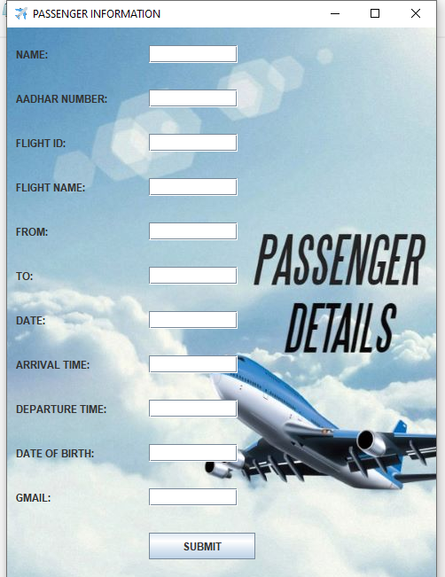
PASSENGERS SHOULD FILL THE PERSONAL DETAILS
LIKE AADHAR NUMBER. GMAIL,NAME AND THE DETAILS OF
THE SELECTED FLIGHT LIKE THE FLIGHT NAME ,FLIGHT ID.
CLICK ON THE “SUBMIT” BUTTON

Slide 11
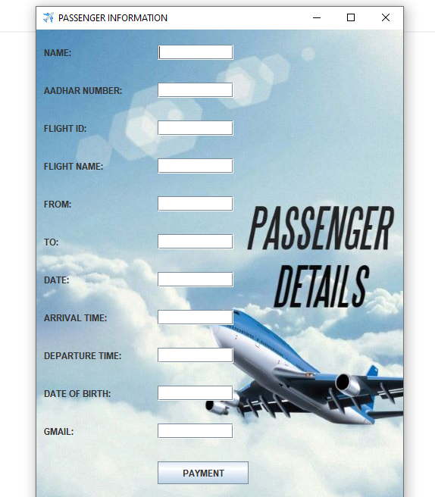
IF THE NUMBER OF PASSENGERS ARE MORE THAN ONE
THEN WE HAVE TO ENTER THE OTHER PASSENGER DETAILS
SAME AS WE ENTERED THE FIRST PASSENGER DETAILS.
NOW CLICK ON THE “PAYMENT “ BUTTON.

Slide 12
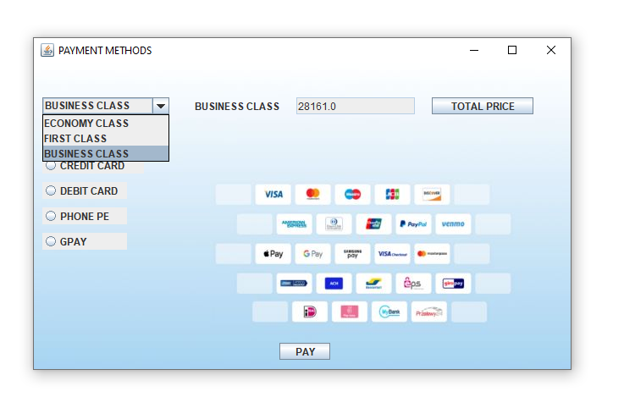
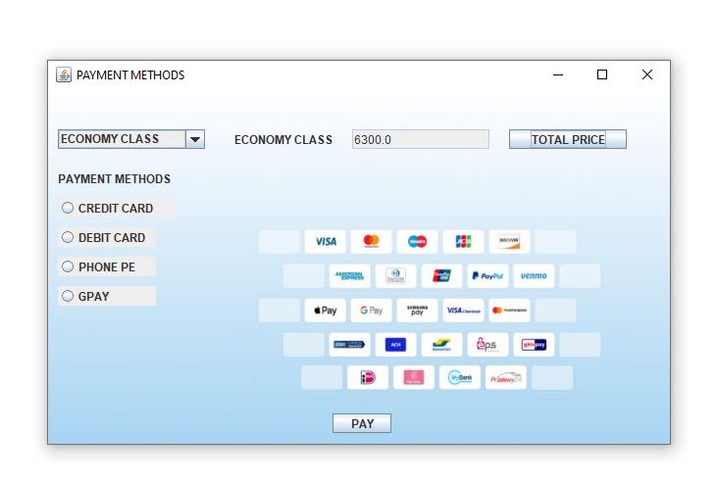
PASSENGER CAN SELECT ECONOMY
CLASS OR FIRST CLASS OR BUSINESS
CLASS AND THE PRICE WILL BE
DISPLAYED FOR THE SELECTED CLASS.
BUSINESS CLASS
ECONOMY CLASS

Slide 13
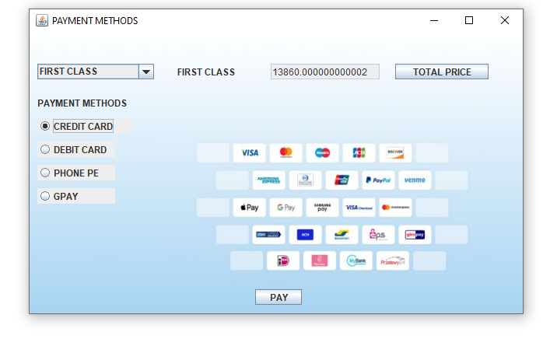
FIRST CLASS
SELECT PAYMENT MODE CREDIT CARD DEBIT CARD GPAY PHONE PE

Slide 14
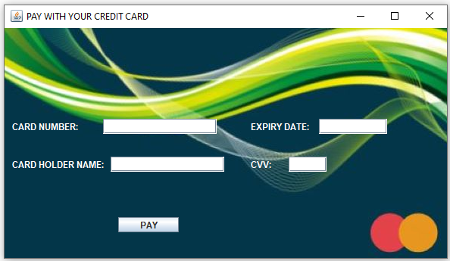
FILL UP YOUR
CARD
DETAILS
CLICK ON THE “PAY” BUTTON
YOUR TICKETS WILL BE BOOKED SUCESSFULLY…

Slide 15
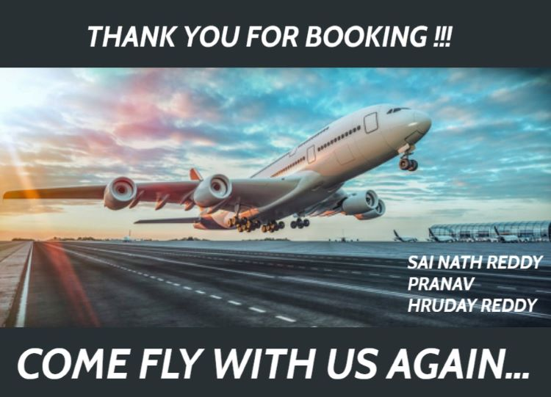

Slide 16
LIMITATIONS OF WORK
WE can create and store as many accounts as we want in a text file, but it takes some time while we are logging in if we have more number of accounts because it has to search through out the file. BUT USING DATA BASE IT TAKES LESS TIME.
WE JUST ADDED LIMITED NUMBER OF CITIES AND FLiGHTS, SINCE WE DON’T KNOW HOW TO USE DATA BASE.
We added only domestic flights of important cities.

Slide 17
EXTENSION OF WORK
After LEARNING HOW TO USE DATA BASE WE WILL MAKE THE PORtal more realistic.
We can add LIVE AVAILABILITY OF FLIGHTS.
WE CAN MAKE THE PORTAL RUN FASTER.
WE CAN MAKE PROJECT MORE REALISTIC AND ATTRACTIVE .
WE can add international flights.

Slide 18
CONTRIBUTION TOWARDS PROJECT
WE REALLY WORKED HARD AND SUCCESSFULLY COMPLETED OUR PROJECT .
ALL OF US CONTRIBUTED EQUALLY FOR THE COMPLETION OF PROJECT.

Slide 19
NIMMA SAI HRUDAY REDDY
CONTRIBUTED IN WRITING THE CODE.
DESIGNED THE USER EXPERIENCE AND FUNCTIONALITY OF THE PROJECT.
ADDED BACKGROUND TO THE FRAMES.
IDENTIFIED THE DIFFERENT POSSIBLE CASES AND MADE PROJECT TO LOOK REALISTIC.
PREPARATION OF POWER POINT PRESENTATION.

Slide 20
PALA JANAKI VENKATA SAI NATH REDDY
DESIGNED THE ALGORITHM OF THE CODE
2. USED FILE HANDLING FOR THE LOGIN PAGE
3. HANDLED THE EXCEPTIONS
4. CONTRIBRUTED TO THE DESIGN OF IMAGES

Slide 21
PRANAV KUMAR TEEPIREDDY
Contributed in writing the code
handled the deigning of the project
added the necessary inputs for the project
Read and understood everyone’s part and wrote the readme file.

Slide 22
THANK
YOU!!

